Slide 1
BCH1200 Discovery in Biology: Evolution

Slide 2
Content
The development of the evolutionary theory
Charles Darwin and Natural selection
Evidence for evolution
Formation of new species

Slide 3
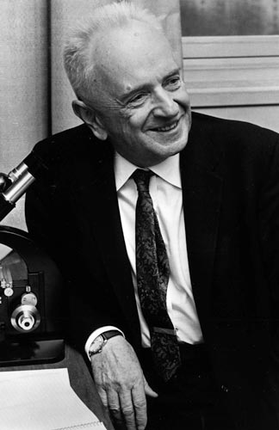
"Nothing in biology makes sense except in the light of evolution.“
Theodosius Dobzhansky (1900-1975)

Slide 4

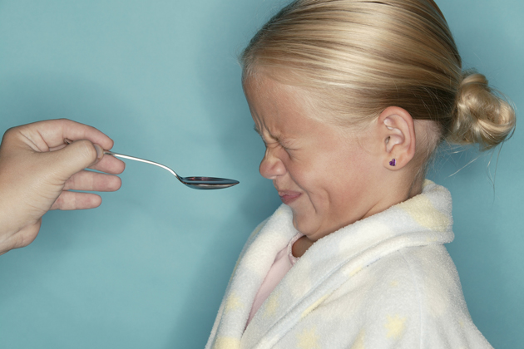

Slide 5
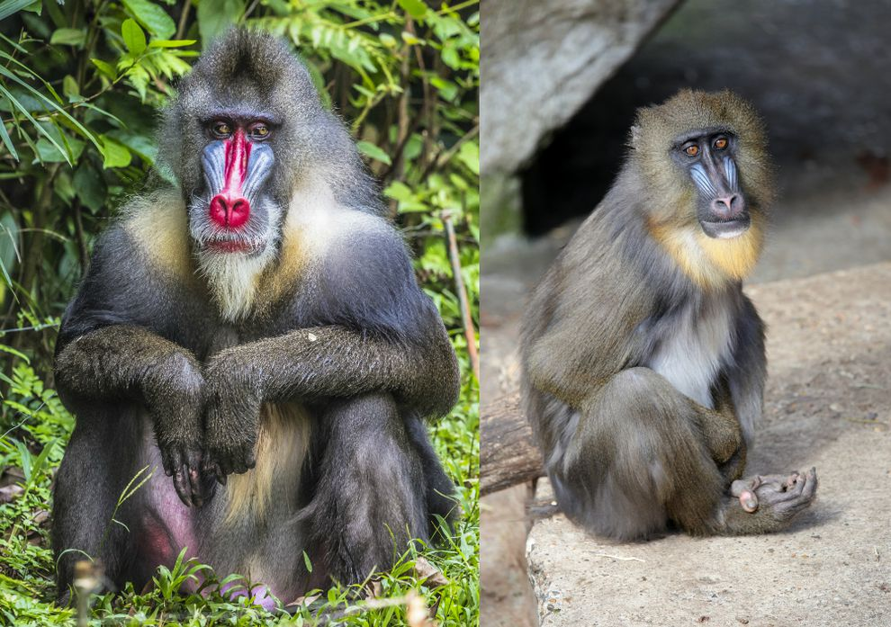
Mandrills are one of nature's most extreme examples of sexual dimorphism

Slide 6
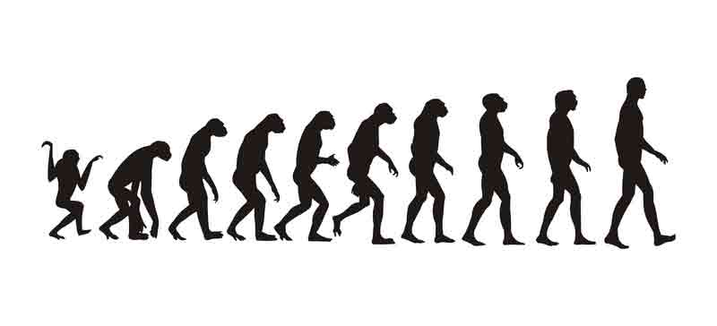
Do species change over time?

Slide 7


An individual may look different as it is growing
how about a species?

Slide 8
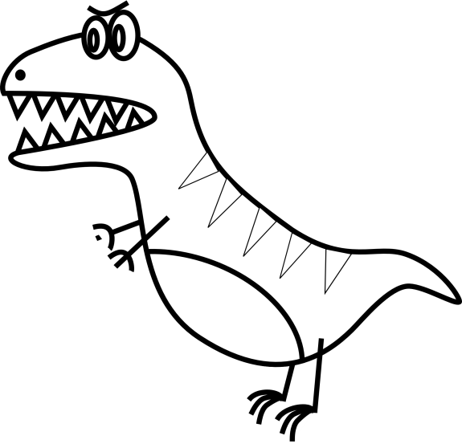


How do we know evolution really occurs and a species changes with time?
1 million years later
clipartist.info
http://www.clker.com
Besse Cooper
(116 years old)

Slide 9
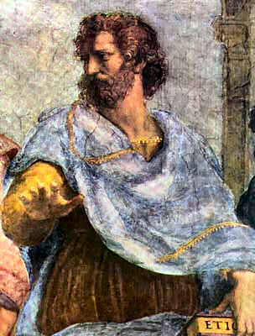
Ancient views on evolution
Pre-socratic Greek philosophers, such as Anaximander and Empedocles:
one type of animal could descend from an animal of another type
However, Aristotle (384 BC – 322 BC) viewed species as perfect and unchanging

Slide 10
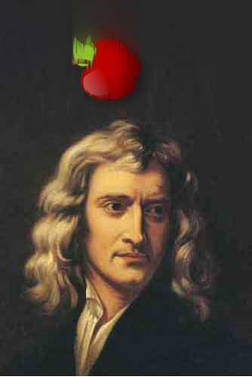
What happened from 17th to 18th century?
The modern science started in the 17th century sought explanations of natural phenomena in terms of laws of nature
Sir Isaac Newton (1643-1727)

Slide 11
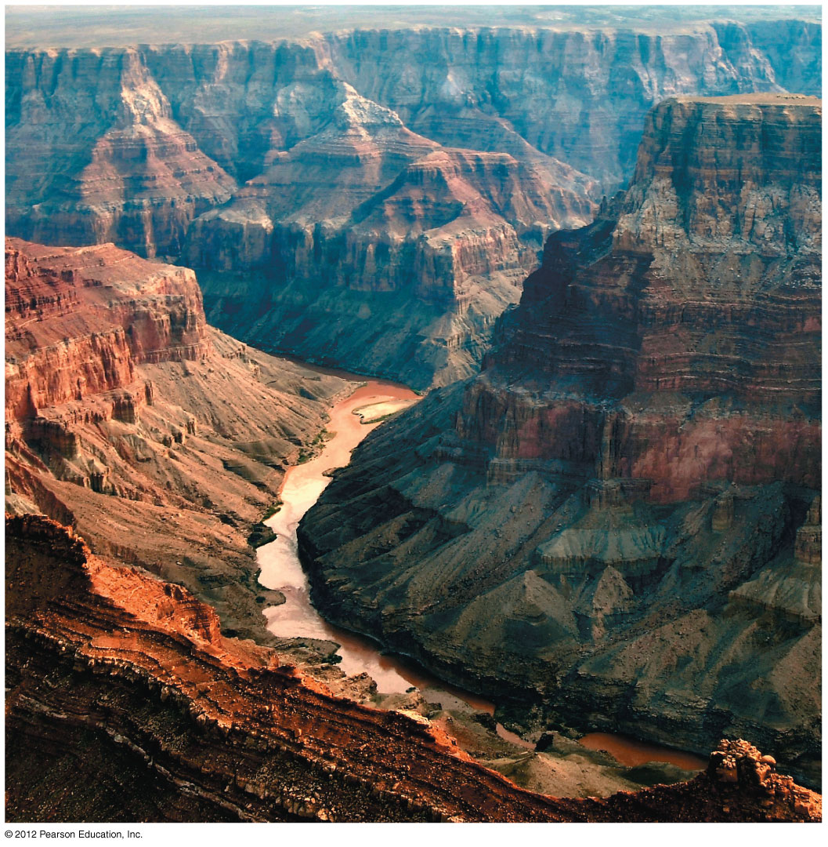
William Smith observed that rocks of different ages preserved different types of fossils, and those fossils were arranged in a regular and determinable order
Grand Canyon

Slide 12
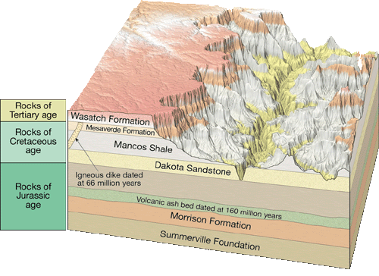
Geology of Grand Canyon

Slide 13
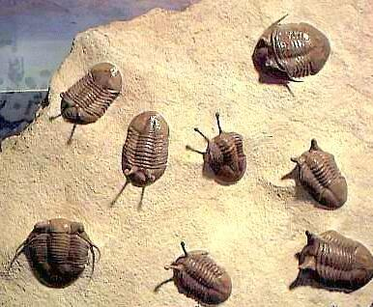
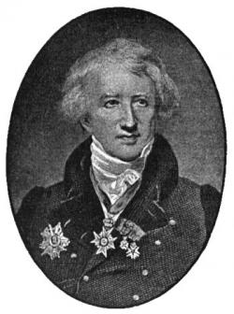
Georges Cuvier (1769-1832) believed that fossils were remains of species that were now extinct
Trilobites
sciencebuzz.org
Notes:
13
Figure 13.4G Strata of sedimentary rock at the Grand Canyon

Slide 14
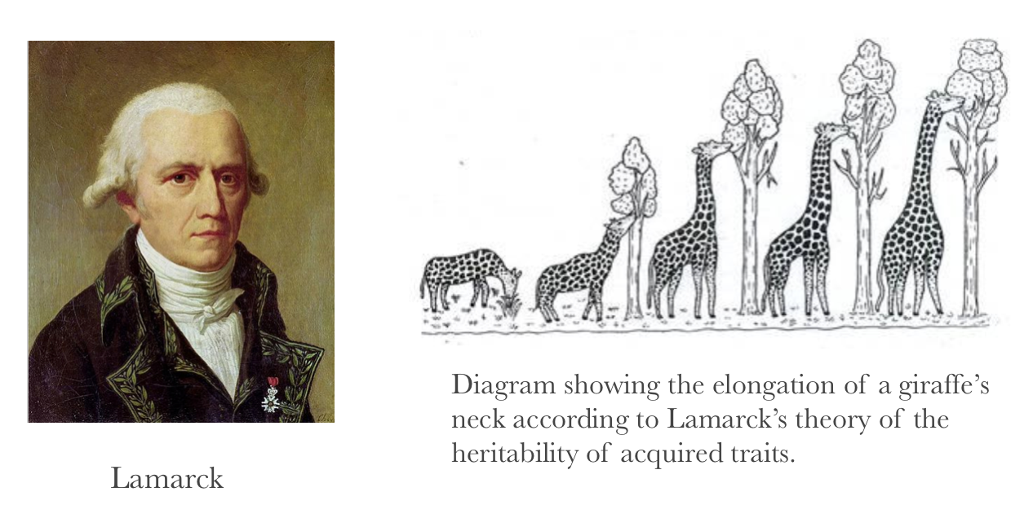
In the early 1800s, Lamarck proposed that
organisms evolve by the use and disuse of body parts
acquired characteristics are passed on to offspring

Slide 15
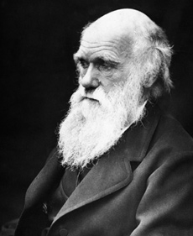
Charles Darwin and Evolution
(1809-1882)

Slide 16
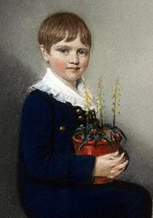
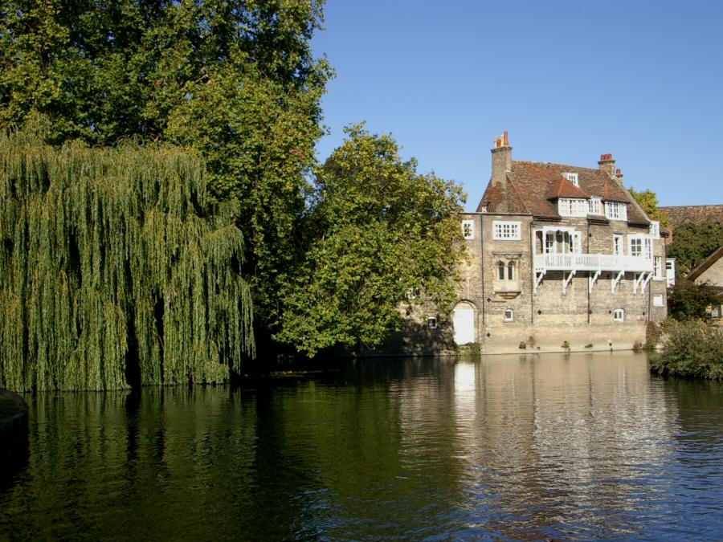
Nature lover since he was a boy
Abandoned medical school in Edinburgh
Sent to Cambridge University to prepare for life as an Anglican parson
The seven-year-old Charles Darwin
Darwin College
University of Cambridge

Slide 17
The voyage of the Beagle
During Darwin’s round-the-world voyage (1831-1836) he was influenced by Lyell’s Principles of Geology, suggesting that natural forces
gradually changed Earth
still operating today
Darwin came to realize that
the Earth was very old
present day species have arisen from ancestral species by natural processes

Slide 18
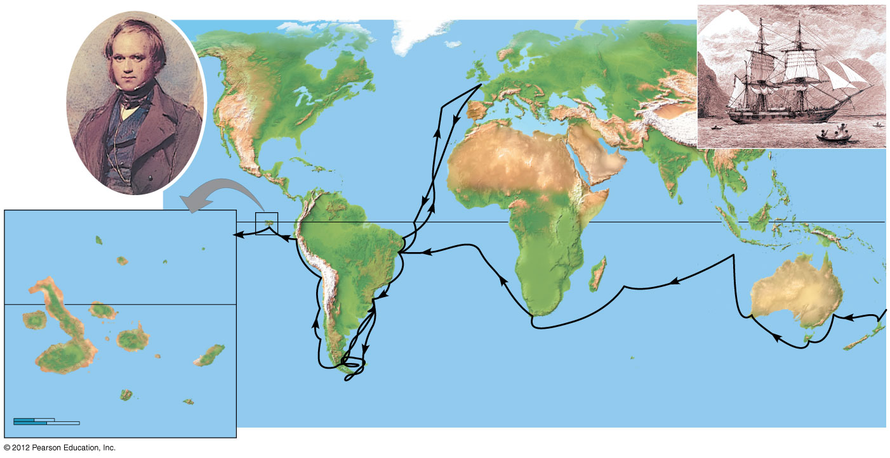
Darwin in 1840
HMS Beagle in port
Great
Britain
Europe
Asia
North
America
ATLANTIC
OCEAN
Africa
PACIFIC
OCEAN
PACIFIC
OCEAN
Galápagos
Islands
Equator
Pinta
South
America
Marchena
Genovesa
Santiago
Equator
Andes
Australia
Daphne Islands
Cape of
Good Hope
Fernandina
Pinzón
PACIFIC
OCEAN
Isabela
Santa
Cruz
Santa
Fe
Cape Horn
Tasmania
San
Cristobal
Tierra del Fuego
New
Zealand
0
40 km
Florenza
Española
0
40 miles
The Beagle Voyage
Notes:
18
Figure 13.1C The voyage of the Beagle (1831–1836)

Slide 19
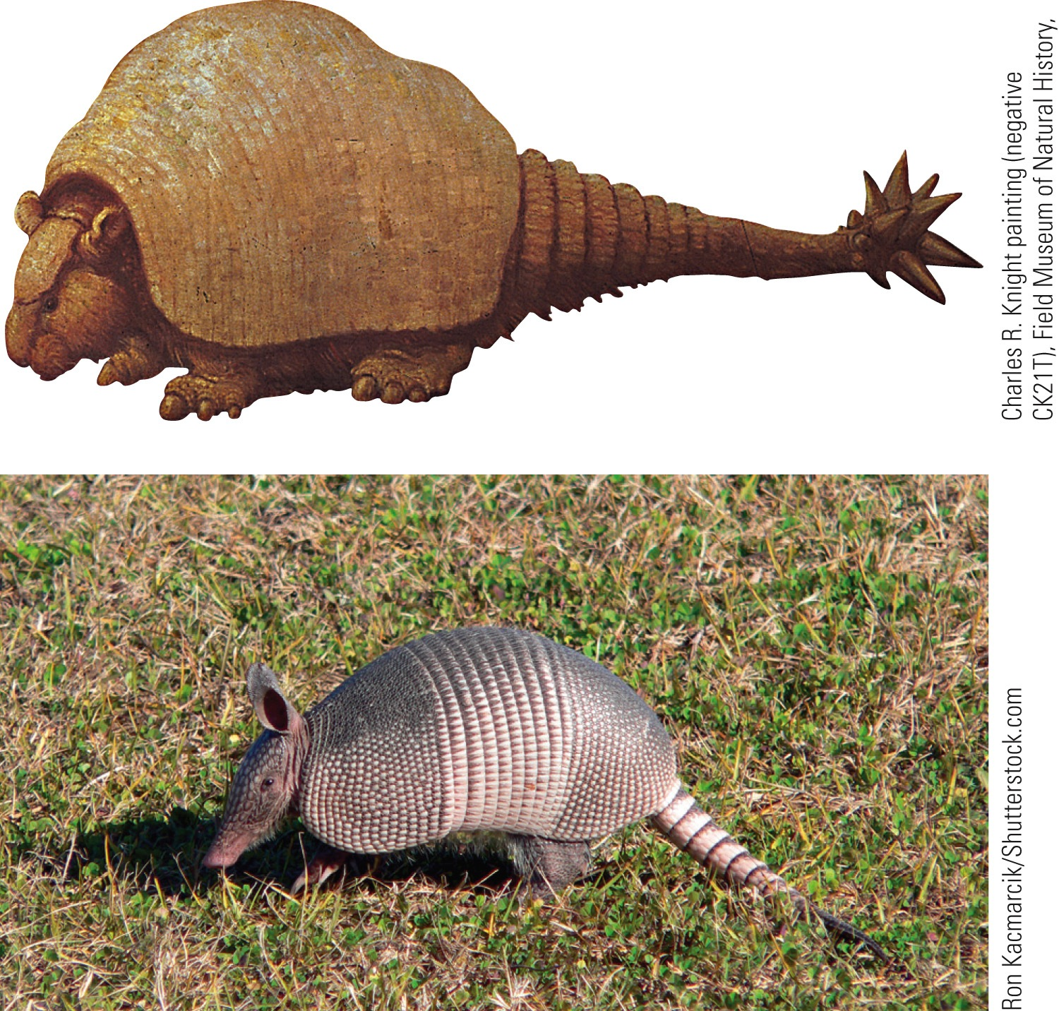
Notes:
FIGURE 20.6 Ancestors and descendants. Darwin hypothesized that even though an extinct glyptodont (top) probably weighed 300 to 400 times as much as a living nine-banded armadillo (Dasypus novemcinctus), their obvious resemblance suggested that they are related. (data from Argentina)

Slide 20
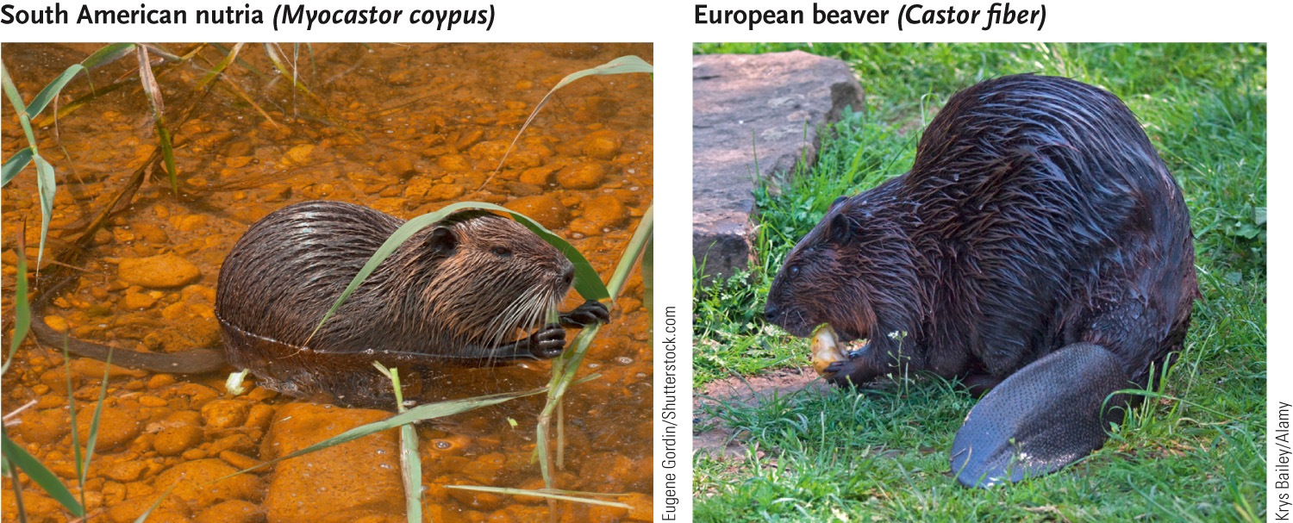
Notes:
FIGURE 20.7 Morphologic differences in species from different continents. Darwin noted that the South American nutria and the European beavers differ in appearance, even though both species are semi-aquatic rodents that feed on vegetation. Notice that nutria have long, round tails, whereas beavers have short, flat tails.

Slide 21
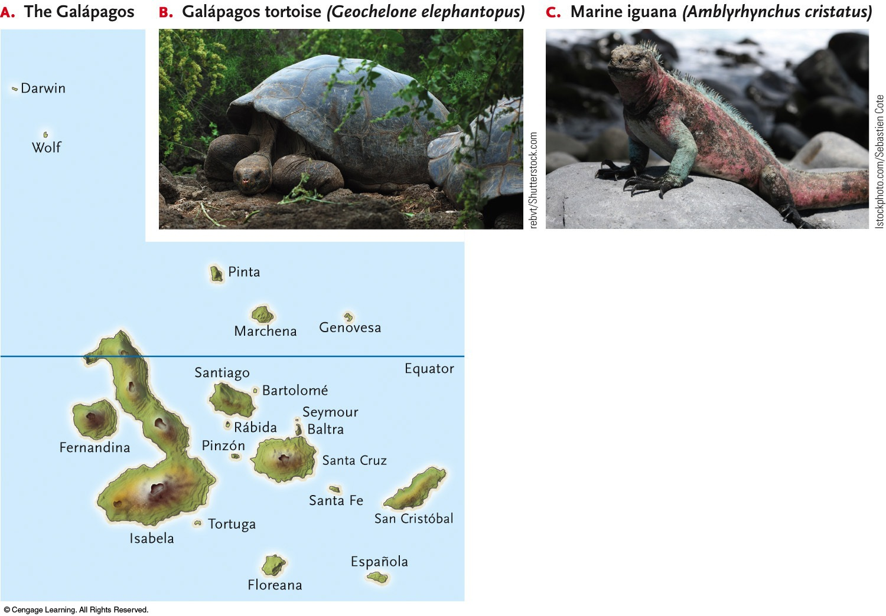
Notes:
FIGURE 20.8 The Galápagos Islands and some of their unusual animal inhabitants. (A) Volcanic eruptions created the Galápagos archipelago (located 1,000 km west of Ecuador) between 3 and 5 million years ago. (B) The islands were named for the giant tortoises found there (in Spanish, galápa means tortoise); this tortoise is native to Isla Santa Cruz. (C) Marine iguanas dive into the Pacific Ocean to feed on algae.

Slide 22
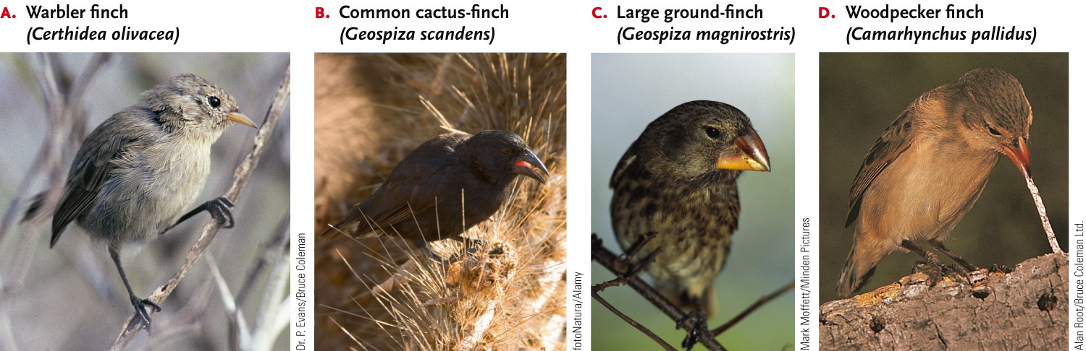
Notes:
FIGURE 20.9 Bill shape and food habits. The 13 finch species that inhabit the Galápagos Islands are descended from a common ancestor, a seed-eating ground finch that migrated to the islands from South America. (A) The warbler finch uses its slender bill to probe for insects in vegetation. (B) The common cactus-finch has a medium-sized bill suitable for eating cactus flowers and fruit. (C) The large ground-finch uses its thick, strong bill to crush cactus seeds. (D) The woodpecker finch uses its bill to hammer at bark and to hold cactus spines, with which it probes for wood-boring insects, such as termites.

Slide 23
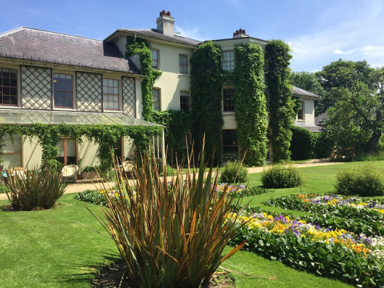
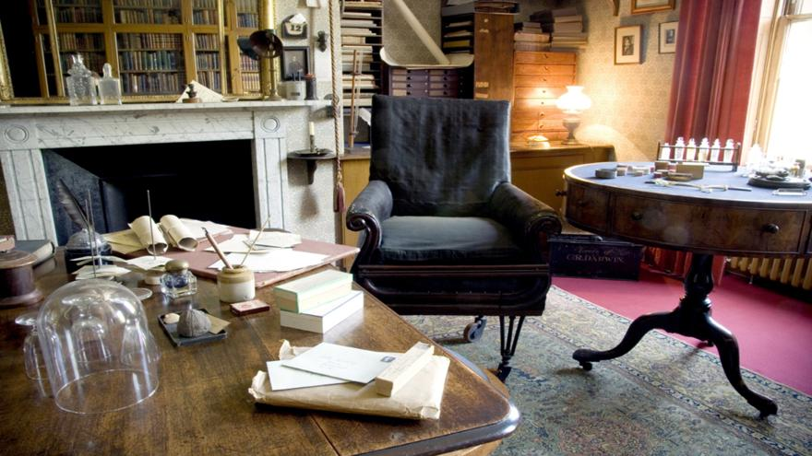
Down House,
Home of Charles Darwin

Slide 24
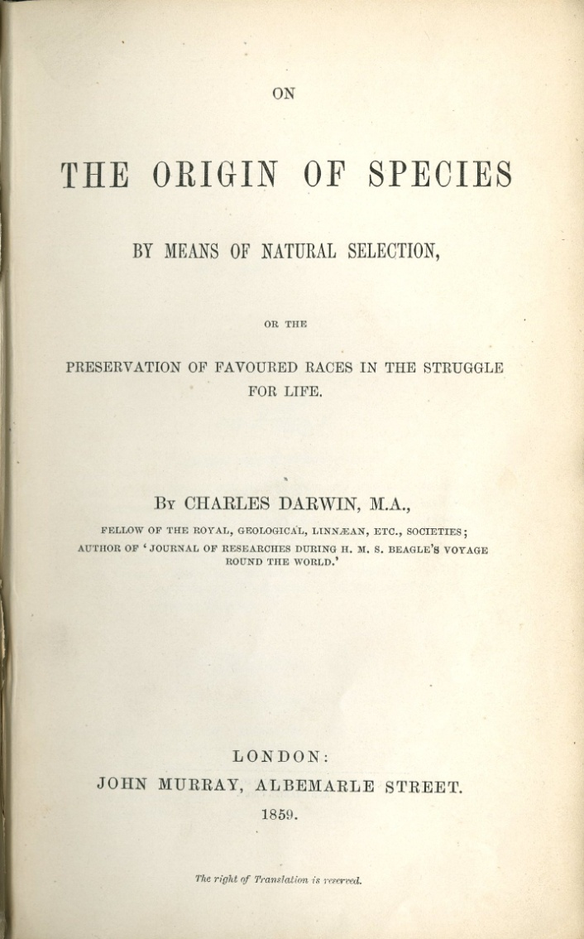
Darwin’s theory of evolution
In 1859, Darwin published On the Origin of Species by Means of Natural Selection

Slide 25
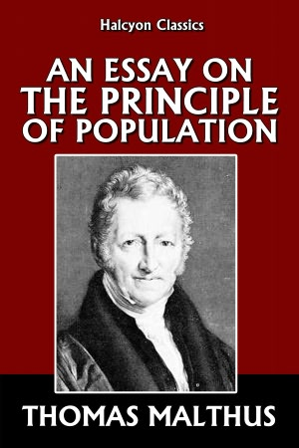
What is natural selection?
Darwin recognized the connection between
natural selection and
the capacity of organisms to over reproduce
An essay written in 1798 by the economist Thomas Malthus argued that human suffering was the consequence of human populations increasing faster than essential resources
barnesandnoble.com

Slide 26
What is natural selection?
Organisms
vary in many traits
produce more offspring than the environment can support
organisms with traits that increase their chance of surviving and reproducing in their environment tend to leave more offspring than others
this unequal reproduction will lead to the accumulation of favorable traits in a population over generations

Slide 27
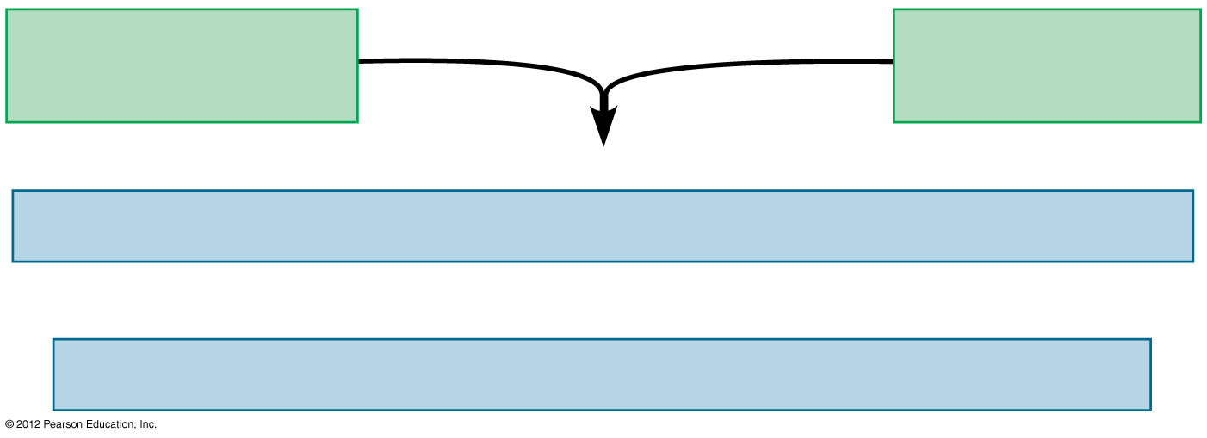
Observations
Heritable variations
in individuals
Overproduction
of offspring
Inferences
Individuals well-suited to the environment tend to leave more offspring.
and
Over time, favorable traits accumulate in the population.
Notes:
27
Figure 13.UN01 Reviewing the Concepts, 13.2

Slide 28
In the early 1800s, Lamarck proposed that
organisms evolve by the use and disuse of body parts
acquired characteristics are passed on to offspring

Slide 29
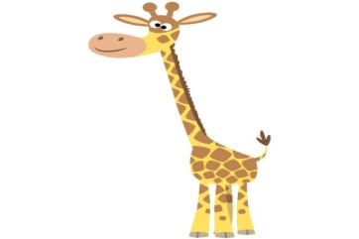

Slide 32
What is natural selection?
Three key points about evolution by natural selection:
Individuals do not evolve: populations evolve.
Natural selection can amplify or diminish only heritable traits. Acquired characteristics cannot be passed on to offspring.
Evolution is not goal directed and does not lead to perfection. Favorable traits vary as environments change.

Slide 33
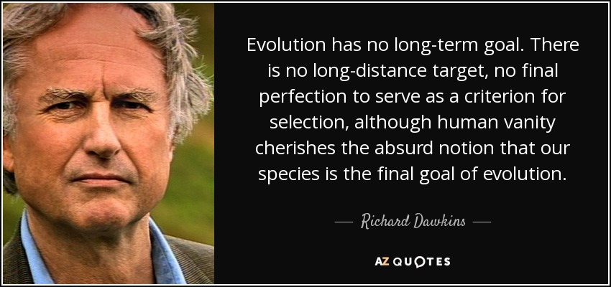

Slide 34
In summary, all you need for evolution is inheritance, variation, and selection

Slide 35
Evidence for evolution
Fossil record
Biogeography of species distribution
Comparative anatomy
Comparative embryology
Molecular biology

Slide 36
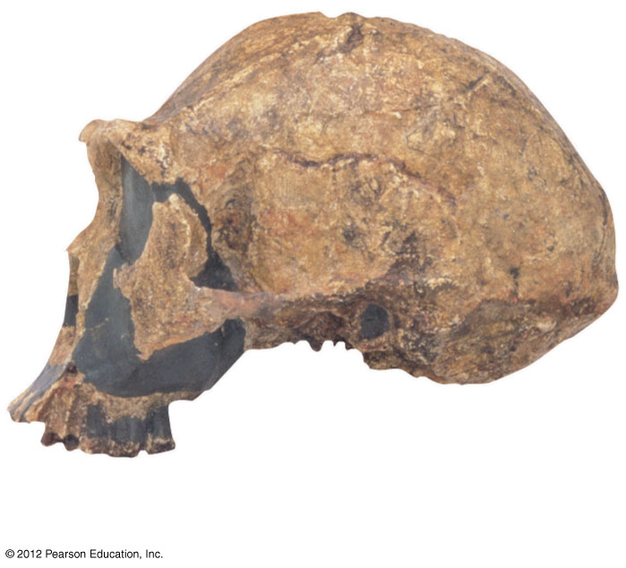
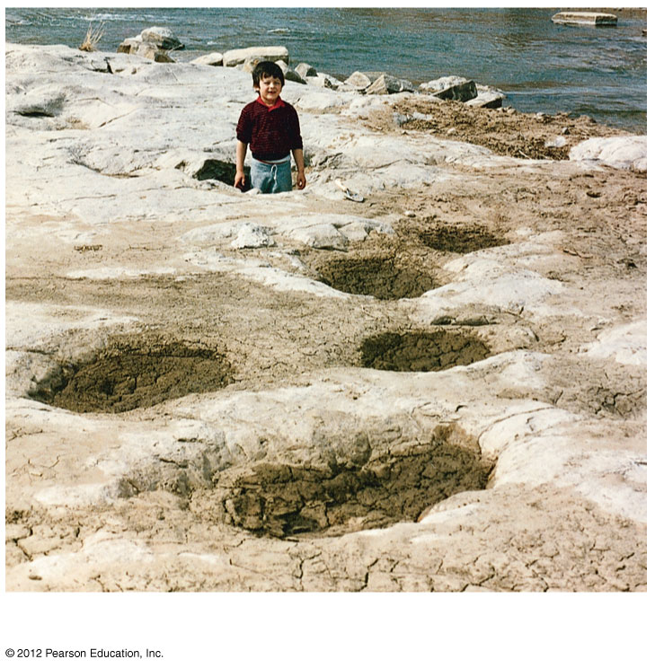
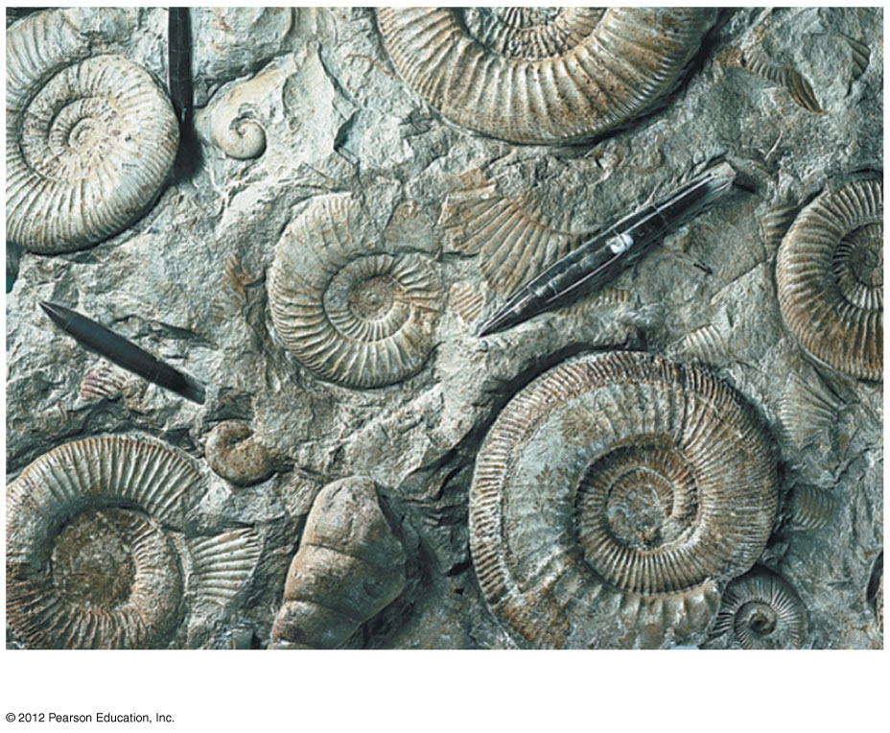
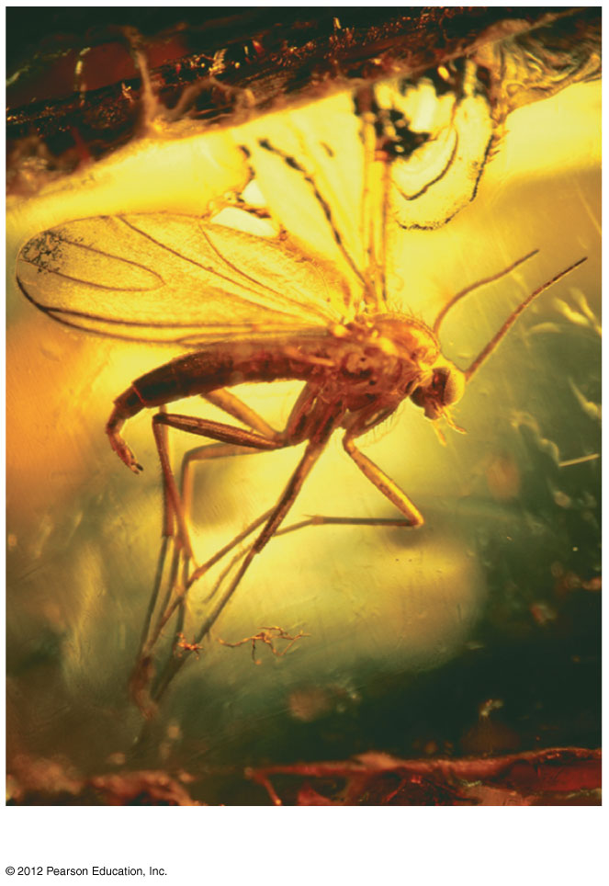
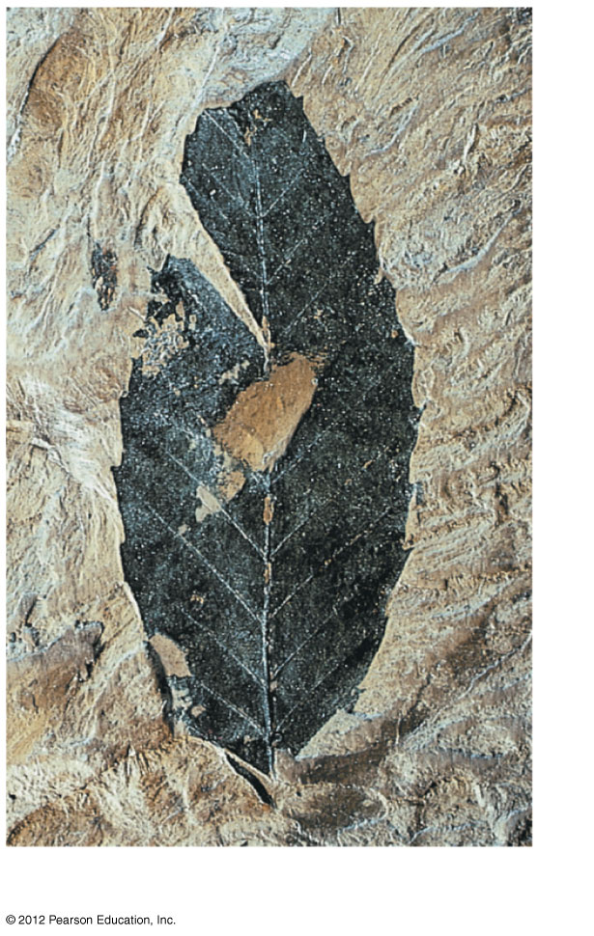
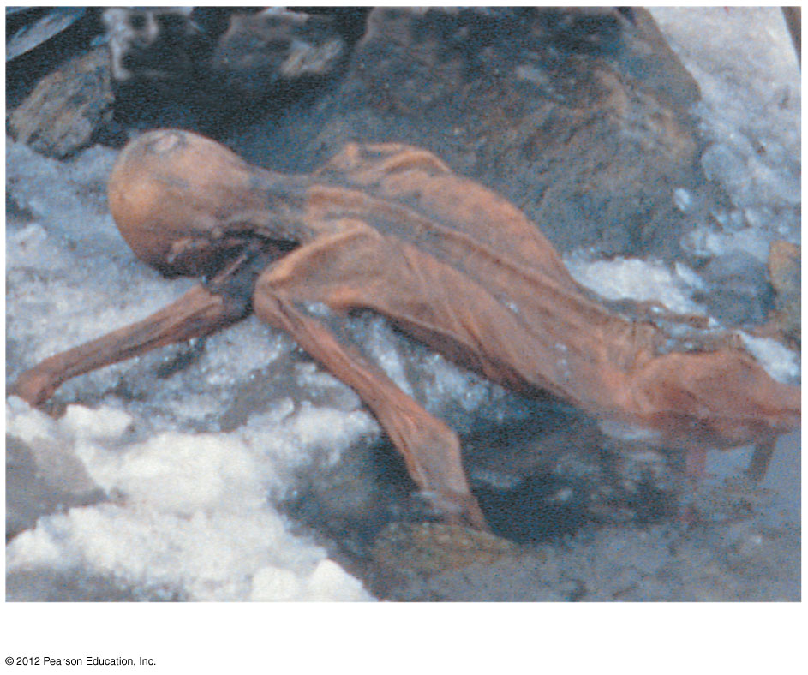
Skull of
Homo erectus
Ammonite casts
Dinosaur tracks
“Ice Man”
Insect in amber
Fossilized organic matter of a leaf
Notes:
36
Figure 13.4A A gallery of fossils: skull of Homo erectus

Slide 37
Fossils provides strong evidence for evolution
The fossil record shows that organisms have evolved in a historical sequence
The oldest known fossils, extending back about 3.5 billion years ago, are prokaryotes
The oldest eukaryotic fossils are about a billion years younger
Another billion years passed before we find fossils of multicellular eukaryotic life

Slide 38
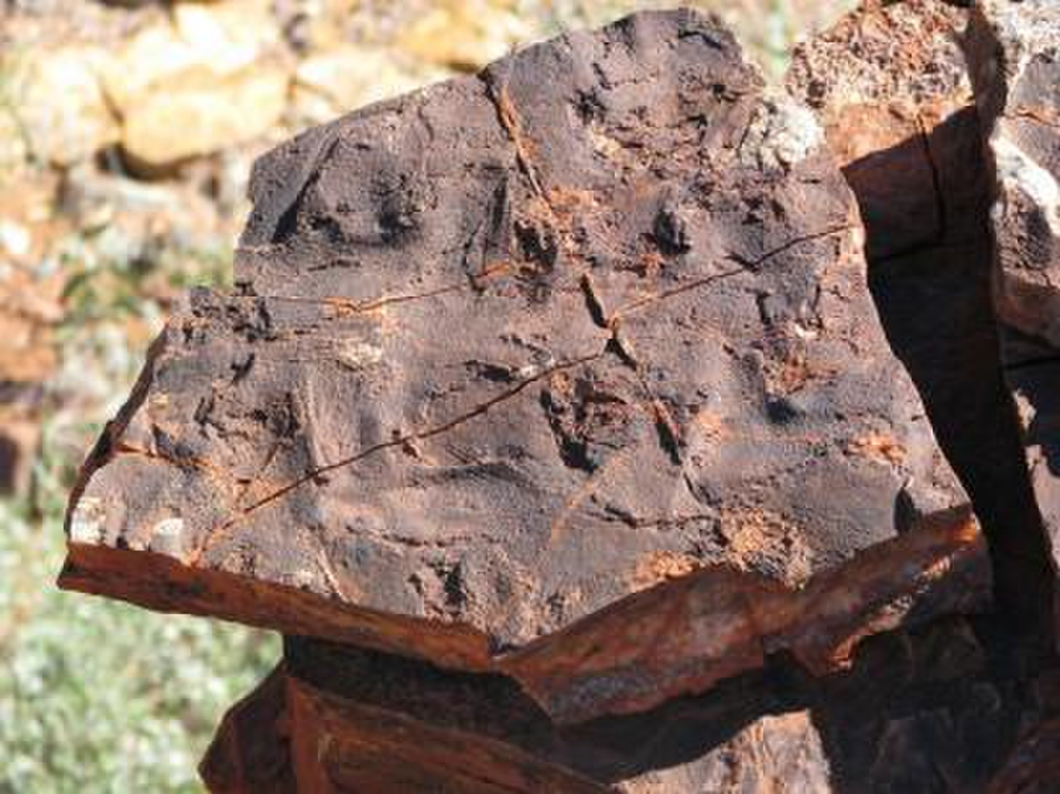
Fossils of 3.5-billion-year-old microbial communities were discovered in Australia.
Credit: Nora Noffke

Slide 39
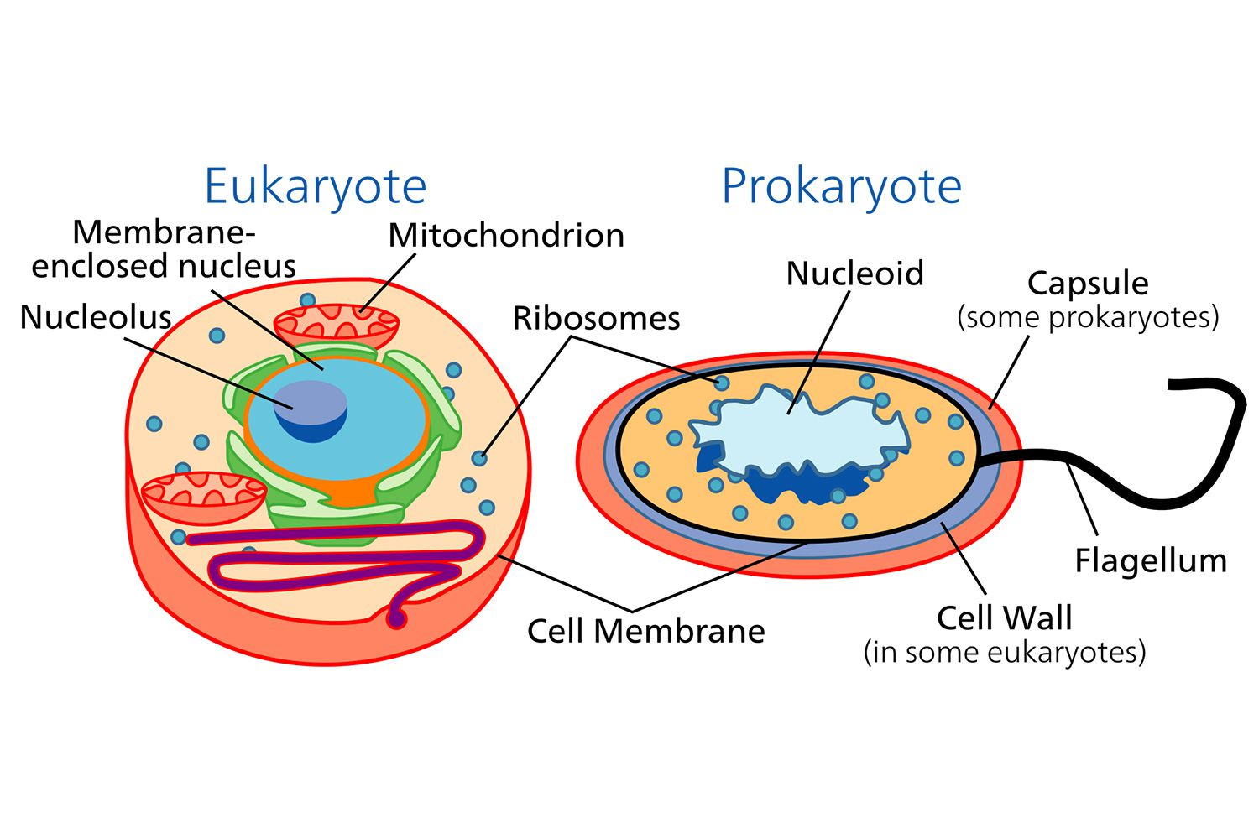

Slide 40
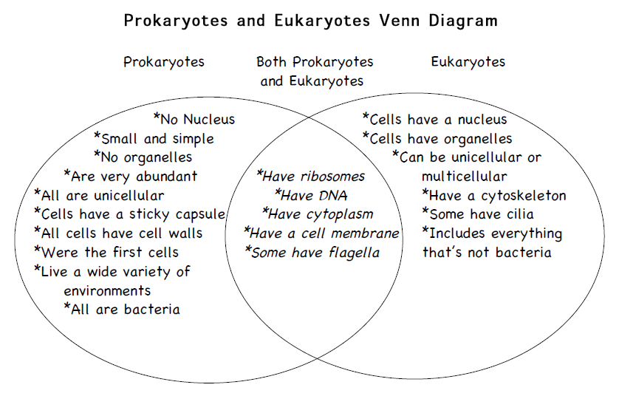

Slide 41
Fossils provides strong evidence for evolution
Many fossils link early extinct species with species living today.
A series of fossils documents the evolution of whales from a group of land mammals.

Slide 42
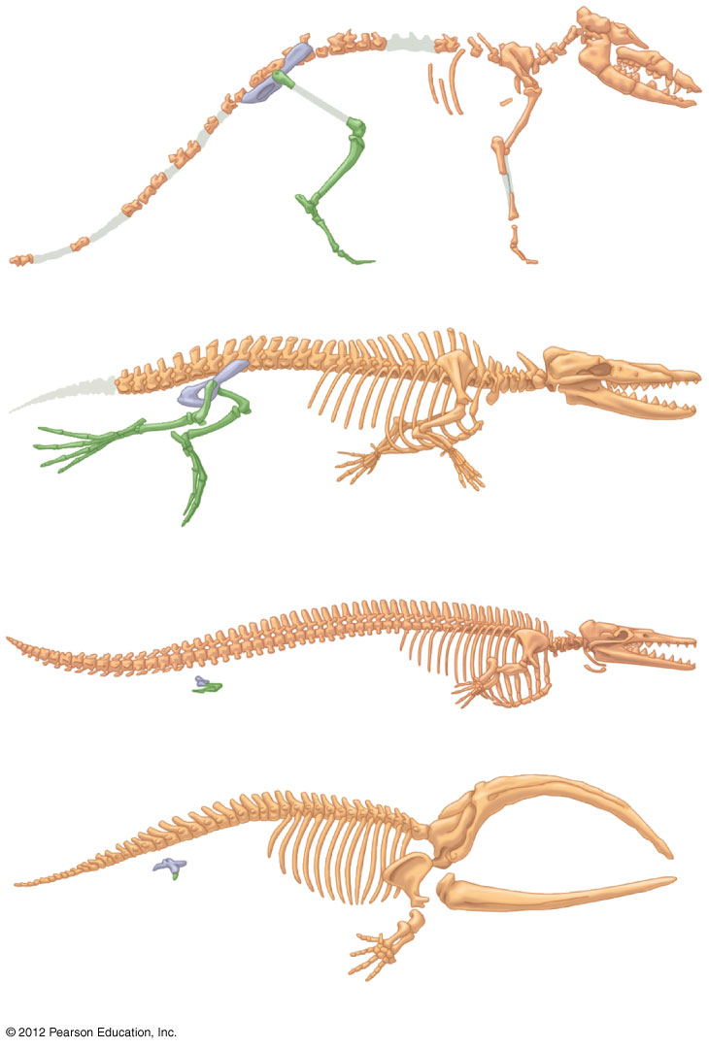
Pakicetus (terrestrial)
Rodhocetus (predominantly aquatic)
Pelvis and
hind limb
Dorudon (fully aquatic)
Pelvis and
hind limb
Balaena (recent whale ancestor)
Notes:
42
Figure 13.4H A transition to life in the sea: fossils of four species that link whales with their land-dwelling ancestors

Slide 43
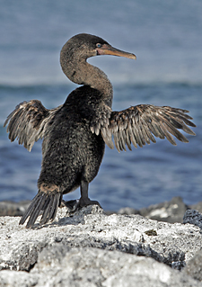
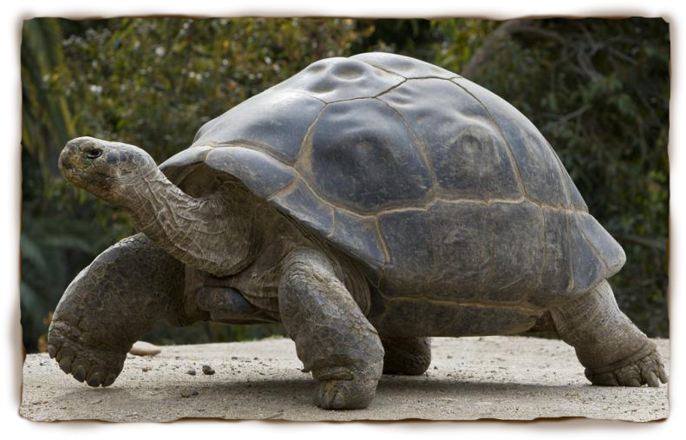
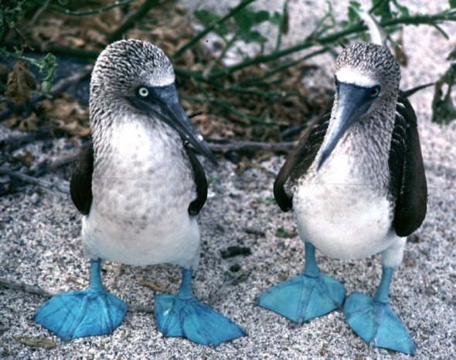
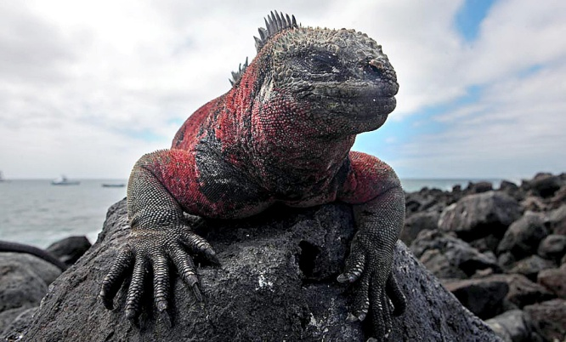
Evidence from biogeography
Darwin noted that Galápagos animals resembled species on the South American mainland more than they resembled animals on islands that were similar but much more distant.

Slide 44
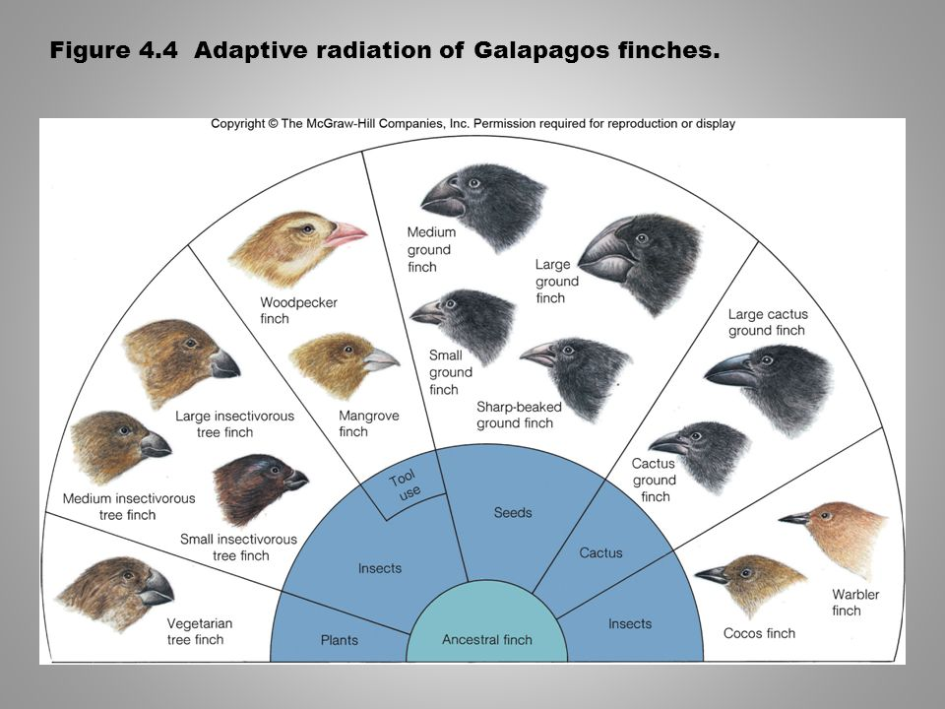

Slide 45
Evidence in comparative anatomy
the comparison of body structures in different species
evolution is a remodeling process
homologous structures have different functions but are structurally similar because of common ancestry

Slide 46
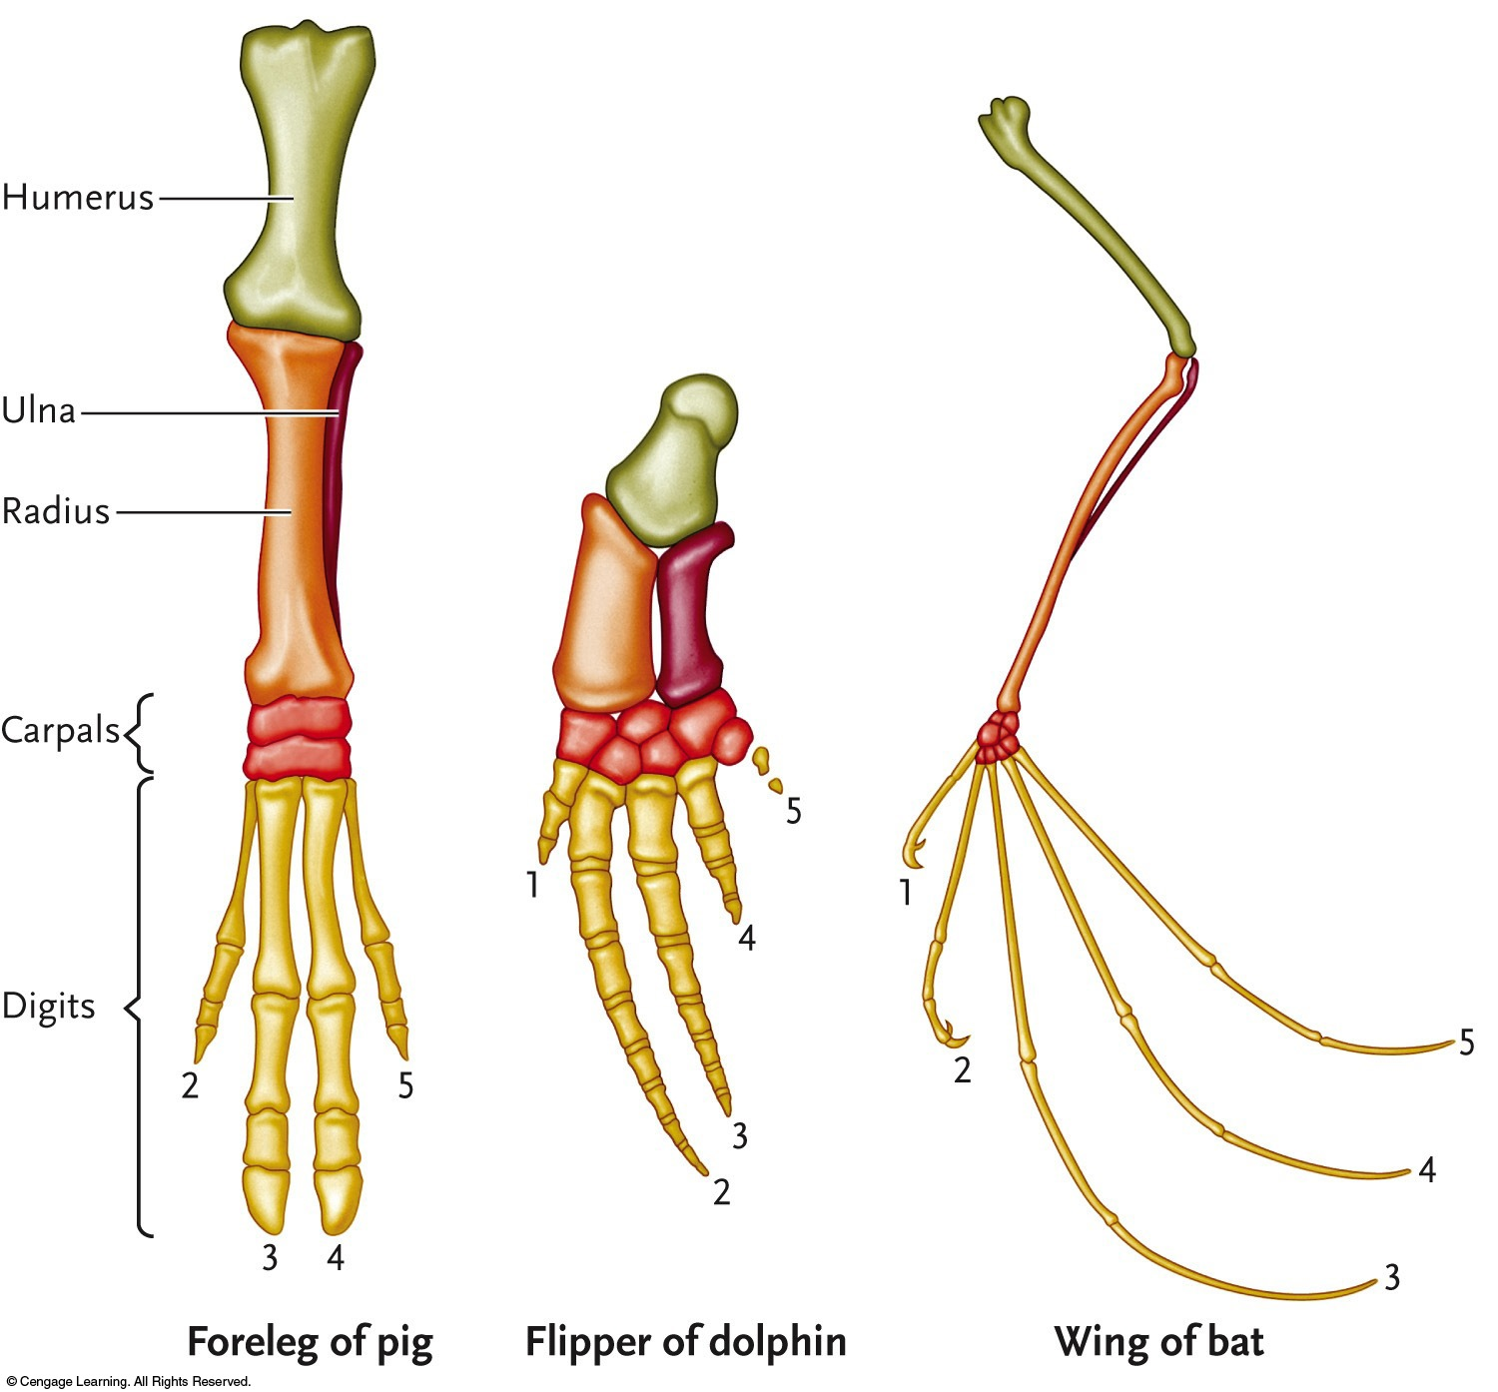

Slide 47
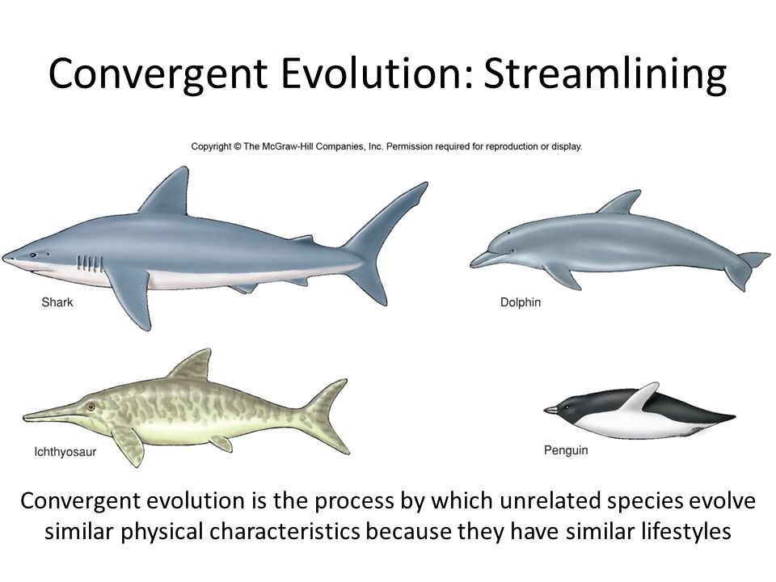

Slide 48
Evidence in comparative embryology
the comparison of early stages of development among different organisms
reveals homologies not visible in adult organisms

Slide 49
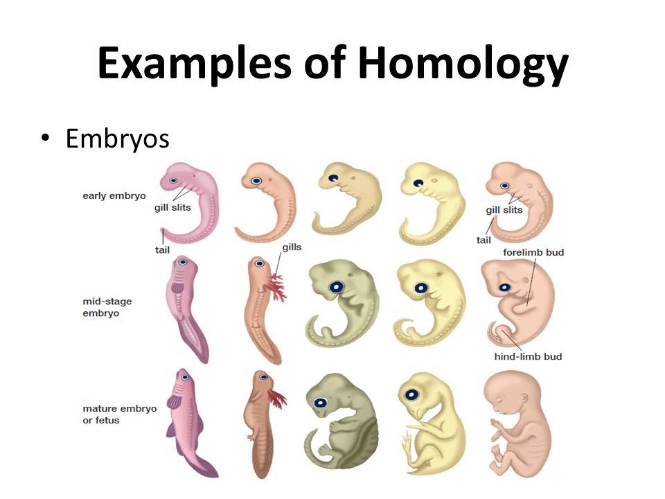

Slide 50
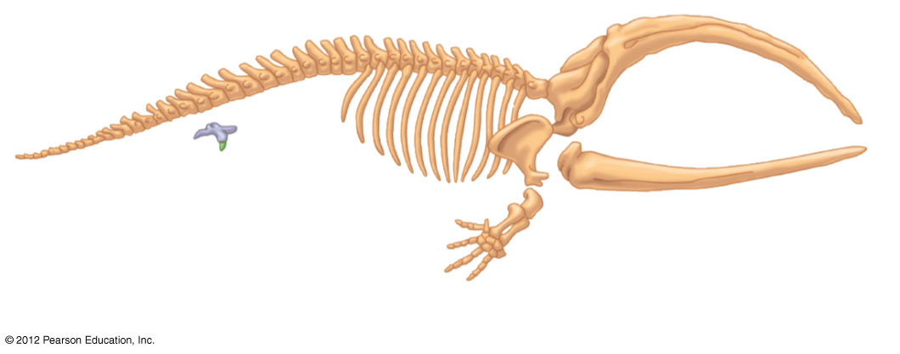
Vestigial structures are remnants of features that served important functions in an organism’s ancestors.
Pelvis and
hind limb
Balaena (recent whale ancestor)
Notes:
50
Figure 13.4H_2 A transition to life in the sea: fossils of four species that link whales with their land-dwelling ancestors (part 2)

Slide 51
Evidence in molecular biology
DNA and amino acid sequences show evolutionary relationships among different organisms
all life shares a common DNA code for the proteins found in living cells
humans and bacteria share homologous genes that have been inherited from a very distant common ancestor
SINE: Short INterspersed Elements (junk DNA) is used to construct the phylogenetic tree of primates

Slide 52
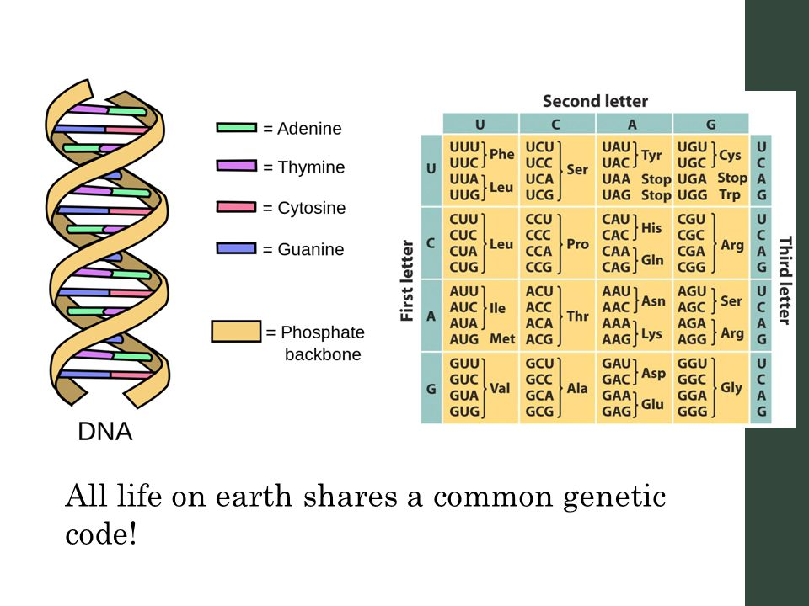

Slide 53
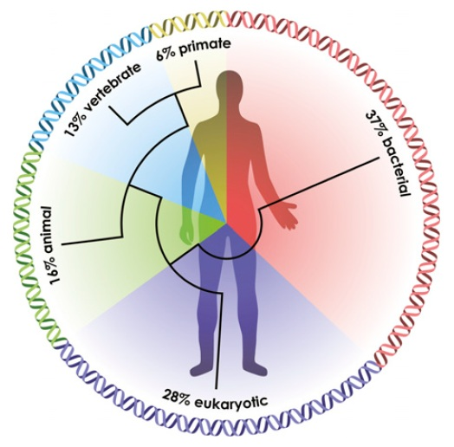

Slide 54
SINE
Accidental insertion of junk DNA sequences near genes
They cannot be removed once inserted
Their presence in the same place in the DNA of two species indicate these species share a common ancestor

Slide 55
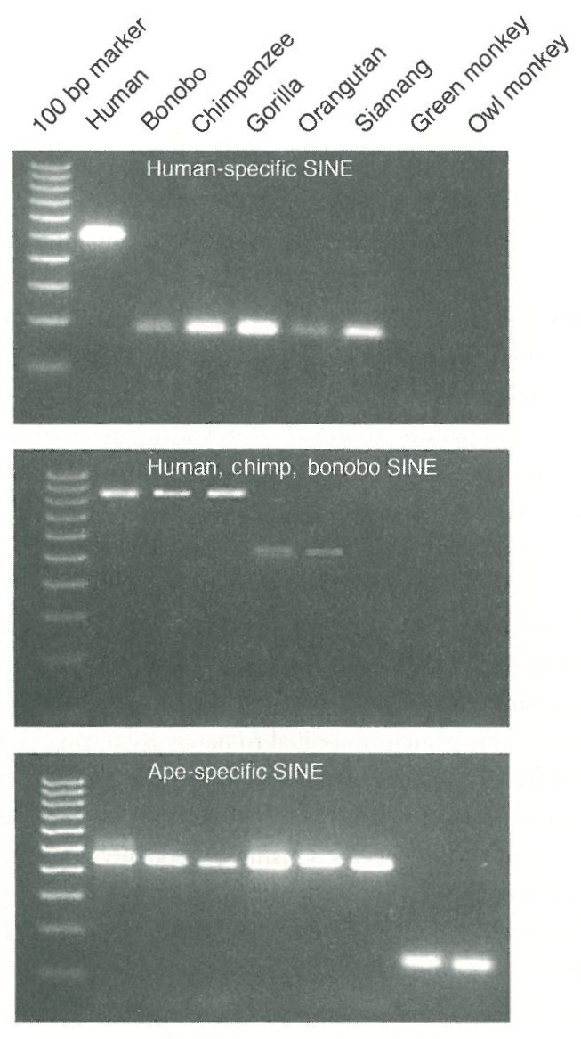
The sharing of SINES indicates the evolutionary relationships among species.

Slide 56
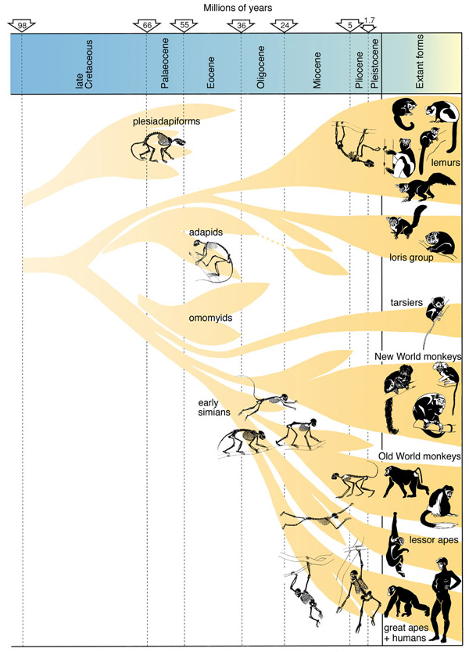
Martin, 1990

Slide 57
Although a species changes with time as a result of natural selection, how can new species formed?

Slide 58
Formation of new species (speciation)

Slide 59
(I) Allopatric speciation
populations of the same species are geographically separated, isolating their gene pools
gene flow between populations is initially prevented by a geographic barrier
reproductive barriers can evolve as a by-product of changes in populations as they adapt to different environments

Slide 60

Notes:
Figure 22.9: The model of allopatric speciation and secondary contact.

Slide 61

South rim
North rim
A. harrisii
A. leucurus
Allopatric speciation of geographically isolated antelope squirrels
Notes:
61
Figure 14.4A Allopatric speciation of geographically isolated antelope squirrels

Slide 62
(II) Sympatric speciation
occurs when a new species arises within the same geographic area as a parent species.
How can reproductive isolation develop when members of sympatric populations remain in contact with each other?
gene flow between populations may be reduced by
(a) polyploidy
(b) habitat differentiation
(c) sexual selection

Slide 63
Sympatric speciation takes place without geographic isolation – (a) polyploidy
Many plant species have evolved by polyploidy in which cells have more than two complete sets of chromosomes
Sympatric speciation can result from polyploidy
within a species (by self-fertilization) or
between two species (by hybridization)

Slide 64

A. Speciation by autopolyploidy in plants
Self- fertilization
Meiosis
2n = 6
4n= 12
Diploid parent karyotype
Through an error in meiosis, a spontaneous doubling of chromosomes produces diploid gametes.
Fertilization of one diploid gamete by another produces a tetraploid zygote (offspring).
Notes:
Figure 22.16: Speciation by autopolyploidy in plants.
A spontaneous doubling of chromosomes during meiosis produces diploid gametes. If the plant fertilizes itself, a tetraploid zygote will be produced.
A spontaneous doubling of chromosomes during meiosis produces diploid gametes. If the plant fertilizes itself, a tetraploid zygote will be produced.

Slide 65

B. Speciation by hybridization and allopolyploidy in plants
Haploid gametes
n = 3
Species A
2n = 6
Diploid gametes
n = 6
Tetraploid zygote (oﬀspring)
2n = 12
Interspecific hybrid
2n = 6
Meiosis
2n = 12
Fertilization
Meiosis
Mitosis
Self- fertilization
Meiosis
Diploid gametes
n = 6
Species B 2n = 6
Haploid gametes
n = 3
Nonhomologous chromosomes will not pair properly during meiosis.
A spontaneous doubling produces polyploid condition with homologous chromosomes.
Notes:
Figure 22.16: Speciation by autopolyploidy in plants.
A spontaneous doubling of chromosomes during meiosis produces diploid gametes. If the plant fertilizes itself, a tetraploid zygote will be produced.

Slide 66
Plant biologists estimate that 80% of all living plant species are descendants of ancestors that formed by polyploid speciation
Hybridization between two species accounts for most of these species.

Slide 67




Polyploid plants
cotton
oats
potatoes
bananas
peanuts
barley
plums
apples
sugarcane
coffee
bread wheat

Slide 68
(b) Habitat differentiation
occurs when subpopulations become dependent on different resources than the parent population
e.g., speciation in the hawthorn fly, Rhagoletis pomonella, also known as the apple maggot fly

Slide 69



Hawthorn
(native to N. America)
Apple
(introduced to N. America in nineteenth century)
(normal)
(mutant)

Slide 70
(c) Sexual selection
e.g., sympatric speciation in cichlids of Lake Victoria
200 species of cichlids inhabit Lake Victoria in East Africa
Sympatric speciation occurred as a result of variations in available resources, and selective mating based on coloration

Slide 71

Intra-sexual selection

Slide 72

Inter-sexual selection
Adult male sage grouses displaying in front of females

Slide 73



P. pundamilia
(male)
P. nyererei
(male)
Normal
lighting
monochromatic orange lighting
monochromatic orange lighting
P. pundamilia
(female)

Slide 74


Slide 75
Additional readings
Jon Turney (2008) Darwin Now. British Council.
Ernst Mayr (2001) What Evolution Is. Basic Books.
David Quammen (2006) The Reluctant Mr. Darwin. W. W. Norton & Company, Inc.
Brian & Deborah Charlesworth (2003) Evolution: A Very Short Introduction. Oxford University Press.
The complete work of Charles Darwin online:
http://darwin-online.org.uk/

Slide 76
Richard Dawkins (2009) The Greatest Show On Earth: The Evidence for Evolution. Free Press.
James A. Shapiro (2012) Evolution: A View From The 21st Century. FT Press Science.
Jonathan Weiner (1994) The Beak Of The Finch. Vintage Books.

